Slide 1
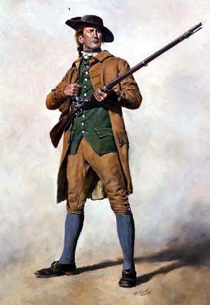
Colonial Newspaper Project
Each class will create their own colonial newspaper.
Write about events leading up to the Revolution.
1 project per class
Graded as a class and as an individual

Slide 2
Objectives
You will research a topic from the time period prior to the American Revolution which is relevant to that conflict.
Anything from the French and Indian War to Lexington and Concord which we learned about.
You will create, write, edit, and publish a newspaper style project.
You will work as a class to complete this project.

Slide 3
Roles
You will need to elect a class president
You will need editors
People who are good at grammar
# depends on class size (maybe 2-3)
Other students will write articles
All roles must be cleared with me first

Slide 4
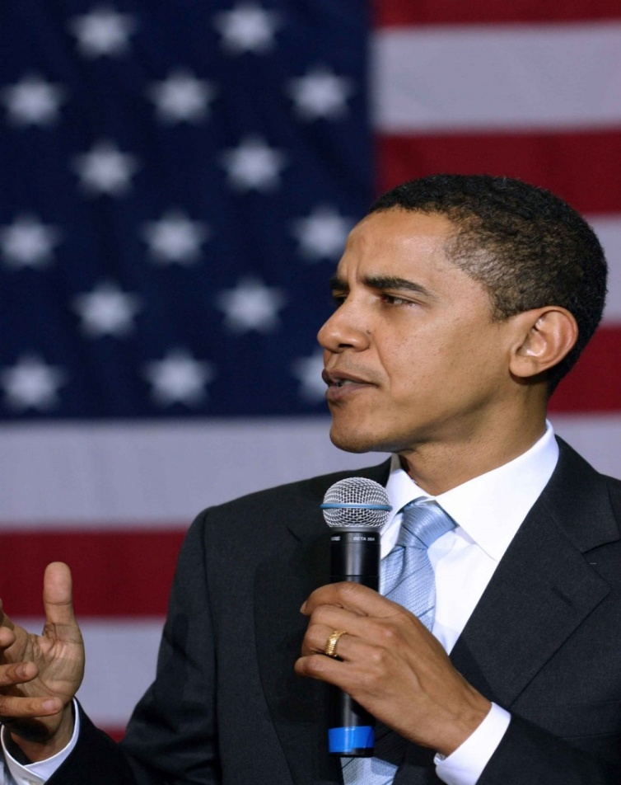
Class President
Elected by class vote.
In charge of making sure the newspaper is complete.
Must make sure everyone has a role.
Must submit a paper with every students name and role to the teacher.

Slide 5
Tips
Articles should be written as if the event happened recently
Articles Should Answer the 5 W’s
Fonts and Font Sizes should be standardized
Avoid Empty Spaces
Include Relevant Pictures with Captions
Use Microsoft Publisher to Print Large Text

Slide 6
Assessment
Class Grade – 10 points
Determined by staff vote
Individual Grade – 20 points
Your article/role (10 points)
Project Participation (10 points)
Total Grade = 30 points

Slide 7
Assessment
Class Grade: Determined by Muhlenberg Staff Vote (10 points)
Top team gets 10 points
2nd place 9 points
3rd place 8 points
4th place 7 points
5th place 6 points
6th place 6 points

Slide 8
Assessment
Article/Role Grade: determined by how well you performed your job. (10 points)
President
How well did the project turn out overall?
Did you organize and assign roles effectively?
Was the project completed on time?
Editors
Were you a good editor?
Did articles with mistakes make it on the newspaper?
Was everything in proper format with a standardized font style and size?
Reporters
Did you hand in an article on the topic you were assigned?
Was your article written like a newspaper article?
Did the article contain accurate information about the topic?

Slide 9
Assessment
Project Participation Grade (10 points)
Did you contribute to the class project?
Did you use your time wisely?
How else did you contribute besides just fulfilling your role?
Did you work well with your group members?

Slide 10
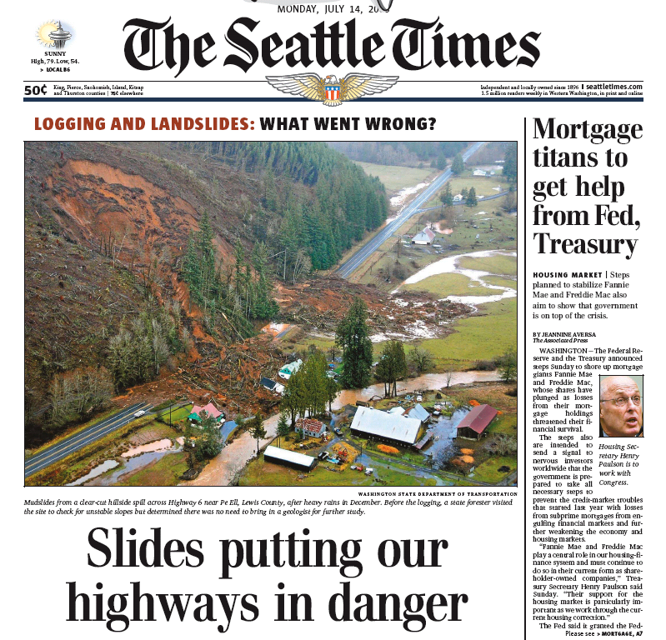

Slide 11
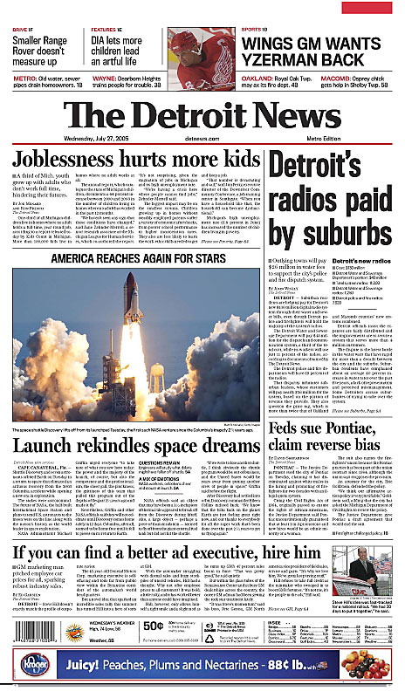

Slide 12
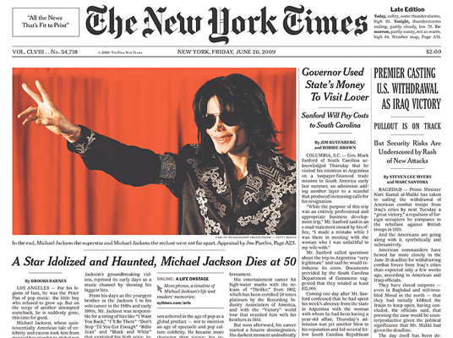

Slide 13
Possible Topics
Proclamation of 1763
Sugar Act
Quartering Act
Stamp Act
Boycotts
Olive Branch Petition
Patrick Henry
John Adams
Sam Adams
Sons of Liberty
Daughters of Liberty
Boston Massacre
Committees of Correspondence
Tea Act
Boston Tea Party
Intolerable Acts
Minutemen
Lexington and Concord
Bunker Hill

Slide 14
Printing Instructions
Class Editors will decide what gets published (printed)
Class Editors should follow these instructions to print
On the classroom computer save all finalized stories/adds
Log on > my computer > P drive > Student Drop Box > Keller> Your Period’s Folder
Make sure all articles are saved properly

Slide 15
Saving Instructions
File
Save As
File Name
P drive
Student Drop Box
Keller
Your Period’s Folder
Save on the P drive!!!!

Slide 16
File Name
Your file name should be your topic and then your last name.
Example: John Smith is writing about the Tea Act
The file name on the P drive should be as follows:
TeaActSmith

Slide 17
Have Fun
Work with your classmates!
If there is time you can put advertisements, weather reports, other news or sports scores in the paper.
Make sure everything is from the colonial period.
Be CREATIVE

Slide 18
Voting
Vote for President
Vote on viewpoint
Patriot
Loyalist

Slide 19
Staff Judging
Thanks for coming today to vote, my students and I very much appreciate it!
Please judge the newspapers on the following criteria:
Aesthetics (does it look like a newspaper front page)
Creativity
Article Quality
Thanks!

